Slide 1
STATUS OF GREEN LAKE
2014

Slide 2
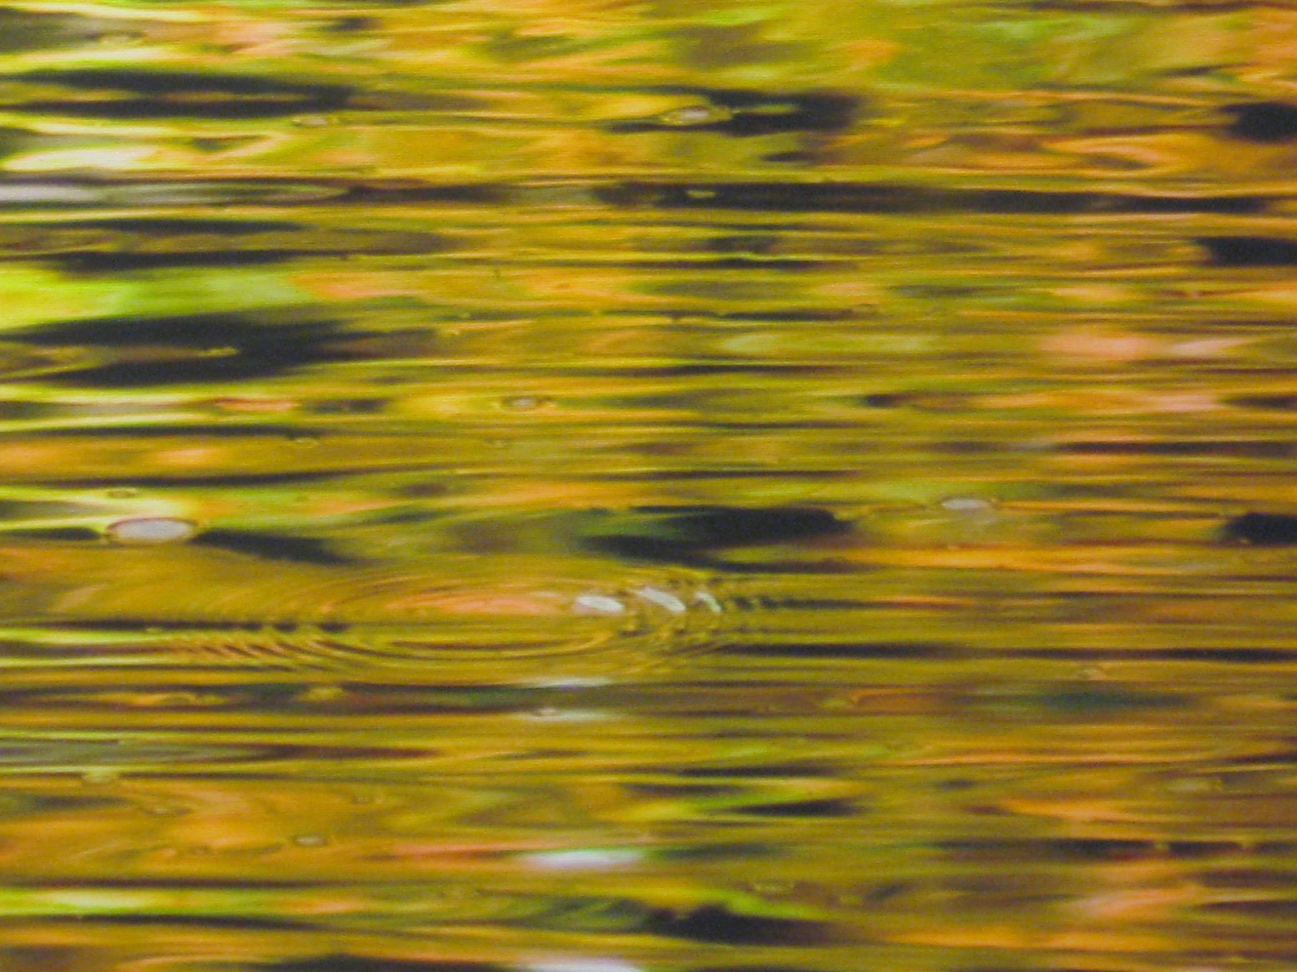
AGENDA
Best Management Practice Update
Impaired Status Explained
Other Lake Accomplishments

Slide 3
Why do we care about the lake?

Slide 4
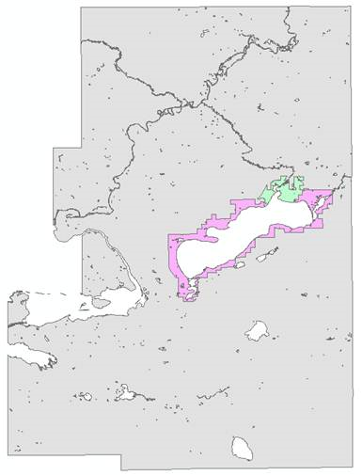
2014 Economic Impact of Big Green Lake
Total Land Base in GL County = 352.1 sq. mi.
Land in Sanitary District / City of GL = 9.1 sq. mi.
Total Tax Base of GL County = $41,818,425
Tax Base of SD / City of GL = $17,527,538
The SD / City of GL make up only 2.5 %
of the land, yet generate 42% of the taxes

Slide 5
Who is involved?
WI Department of Natural Resources
USDA Natural Resources Conservation Service
Green Lake Sanitary District
Green Lake Association
Green Lake County Land Conservation
Fond Du Lac County Land Conservation
City of Green Lake
City of Ripon
Townships
Other Government and Non-profit Agencies
Most Important: Landowners and Homeowners

Slide 6
LAND CONSERVATION
Implement Best Management Practices
Reduce Runoff
Reduce Phosphorous
Approximately 1.5 lbs. P per 1 Ton Soil
Biggest Dilemma is Funding

Slide 7
National Water Quality Initiative (NWQI)
NWQI program adopted in 2012
In 2014 – 174 Watersheds chosen nationwide
Approximately 30 million allocated each year

Slide 8
Big Green Lake NWQI
2012 Signup:
63 Practices
$353,800 Federal Cost Share
$453,135 Total
2013 Signup:
61 Practices
$406,200 Federal Cost Share
$529,700 Total
2014 Signup:
68 Practices
$213,400 Federal Cost Share
$330,613 Total
2015 Signup: ? ? ?

Slide 9
Big Green Lake Cost Share Funding

Slide 10
Big Green Lake Estimated Phosphorous Reduction

Slide 11
Types of Best Management Practices
Hard Practices
Earth Embankments [23 dams (6)]
Terraces [13,680 ft (1,414)]
Waterways [12,177 ft (8,795)]
Streambank Protection [10,880 ft (5,000)]
Waste Storage Facilities [3 no (2)]
Soft Practices
Reduced Tillage, No-till (120 ac), Cover Crops,
Contouring (15 ac), Buffer Strips

Slide 12
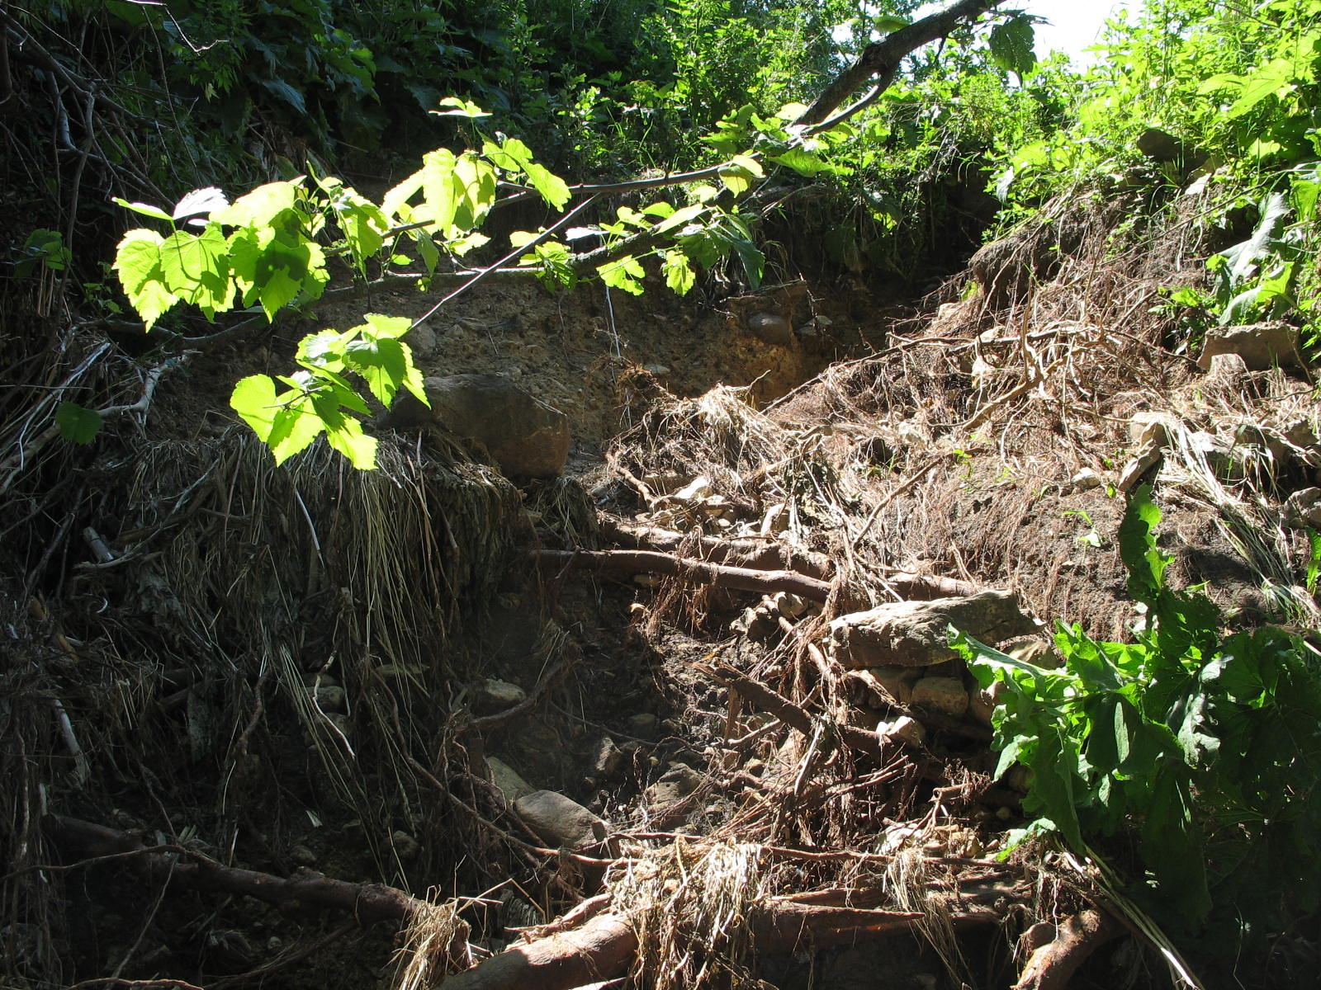
Hard Practice Examples Typical Gully Erosion on Non-cropland

Slide 13
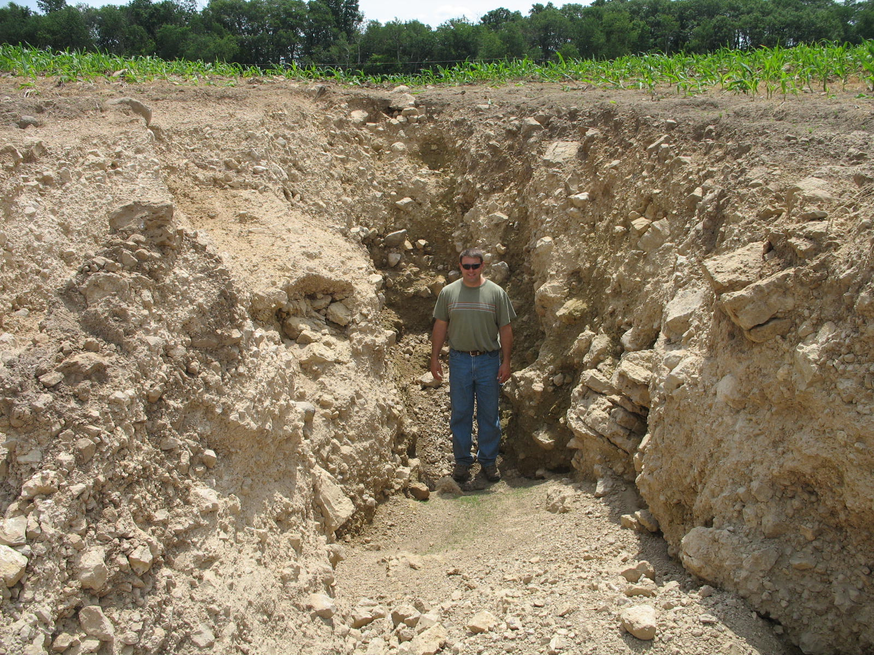
Non-Typical Gully Erosion on Non-cropland

Slide 14
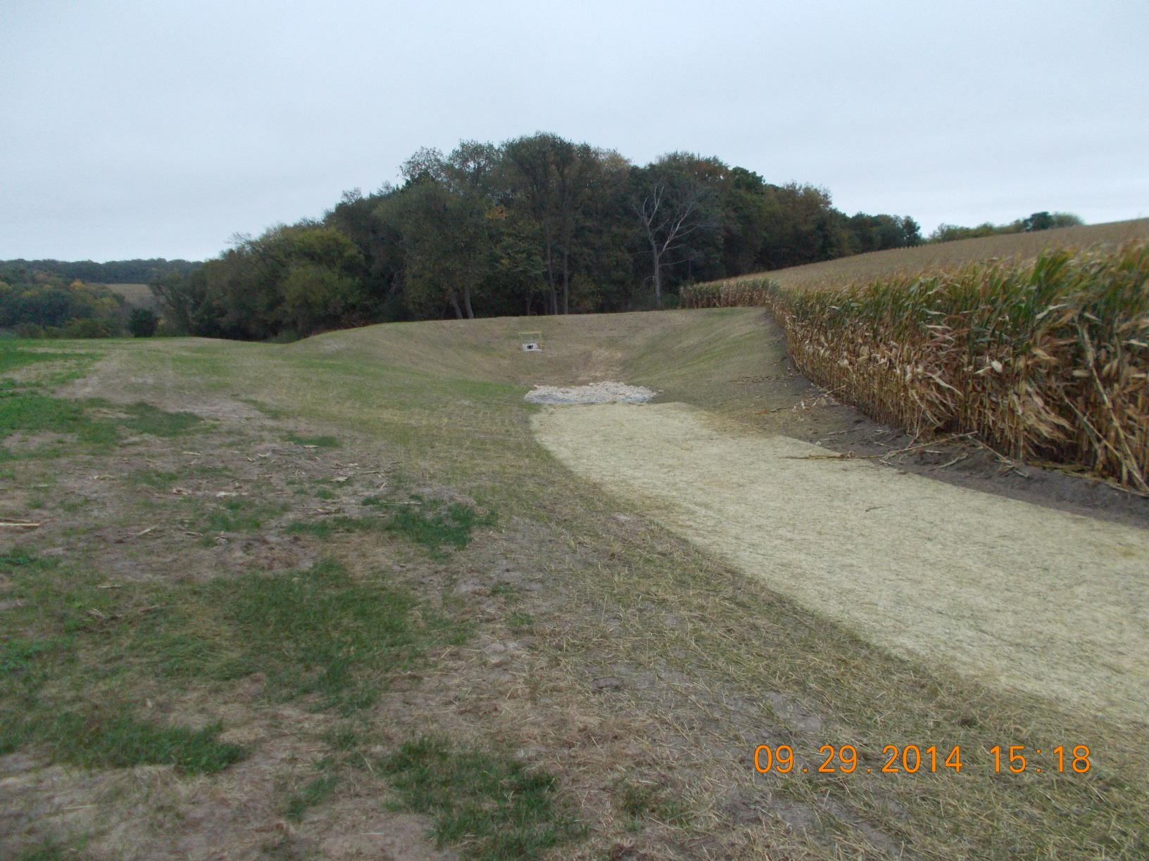
Water and Sediment Control Basin

Slide 15
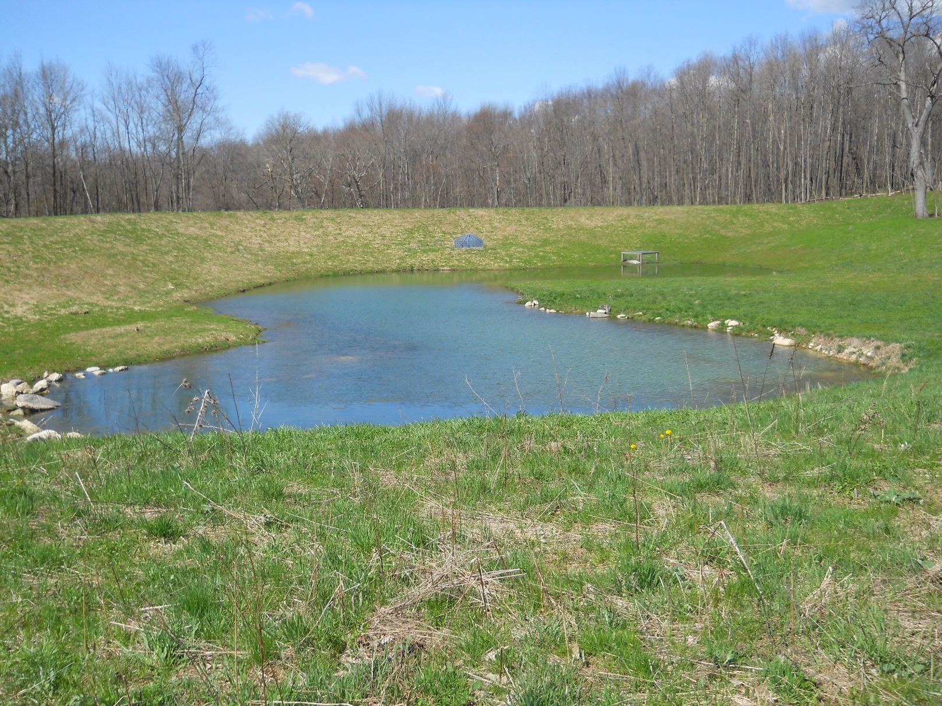
Embankment Pond

Slide 16
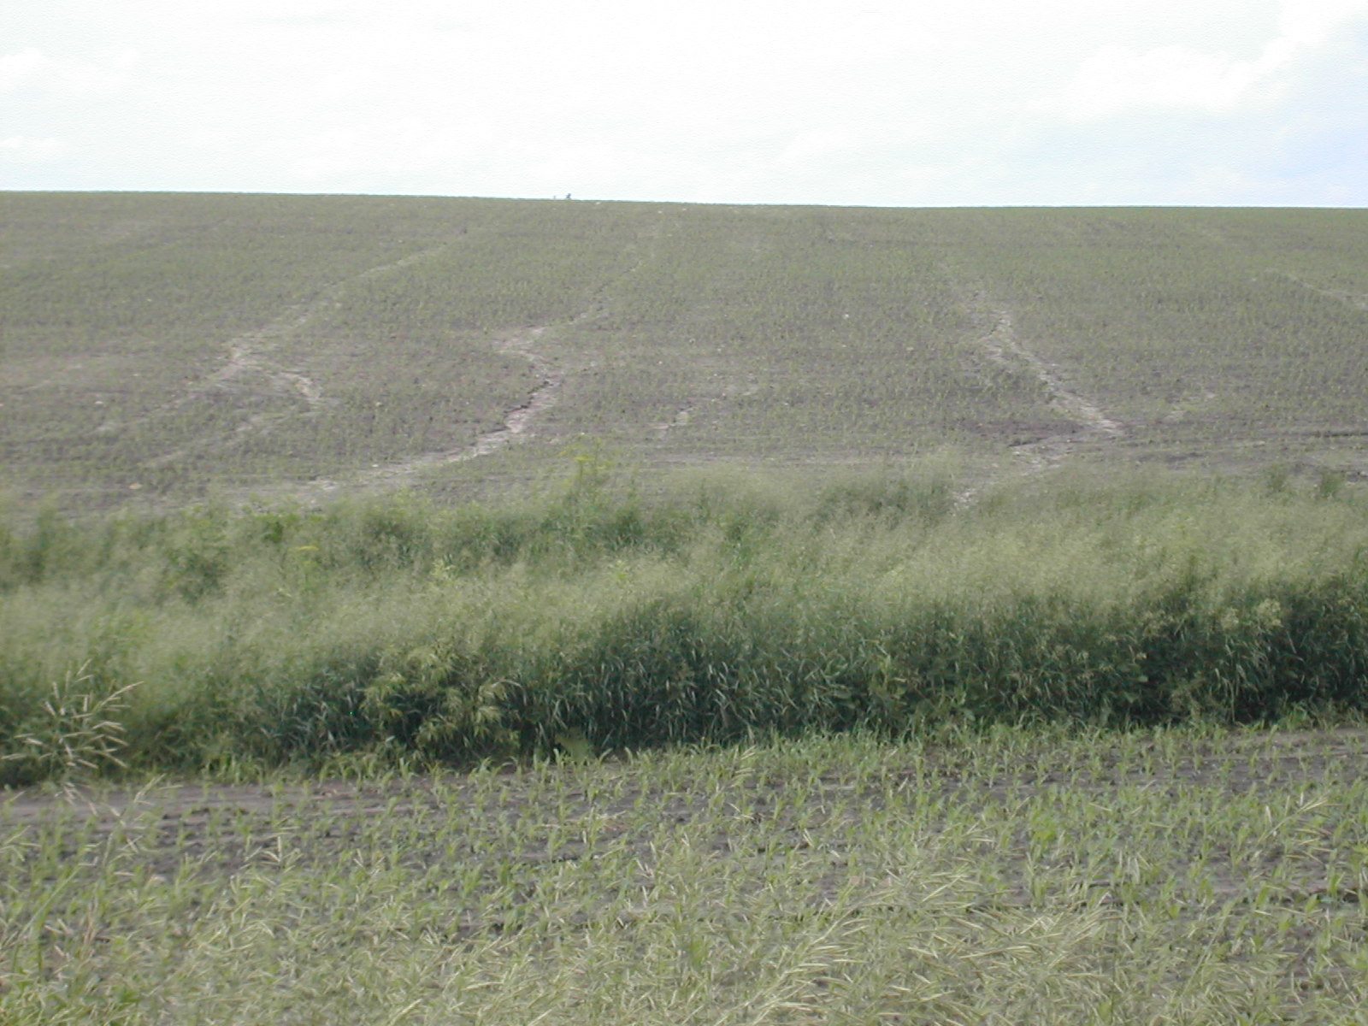
Typical Erosion on Cropland

Slide 17
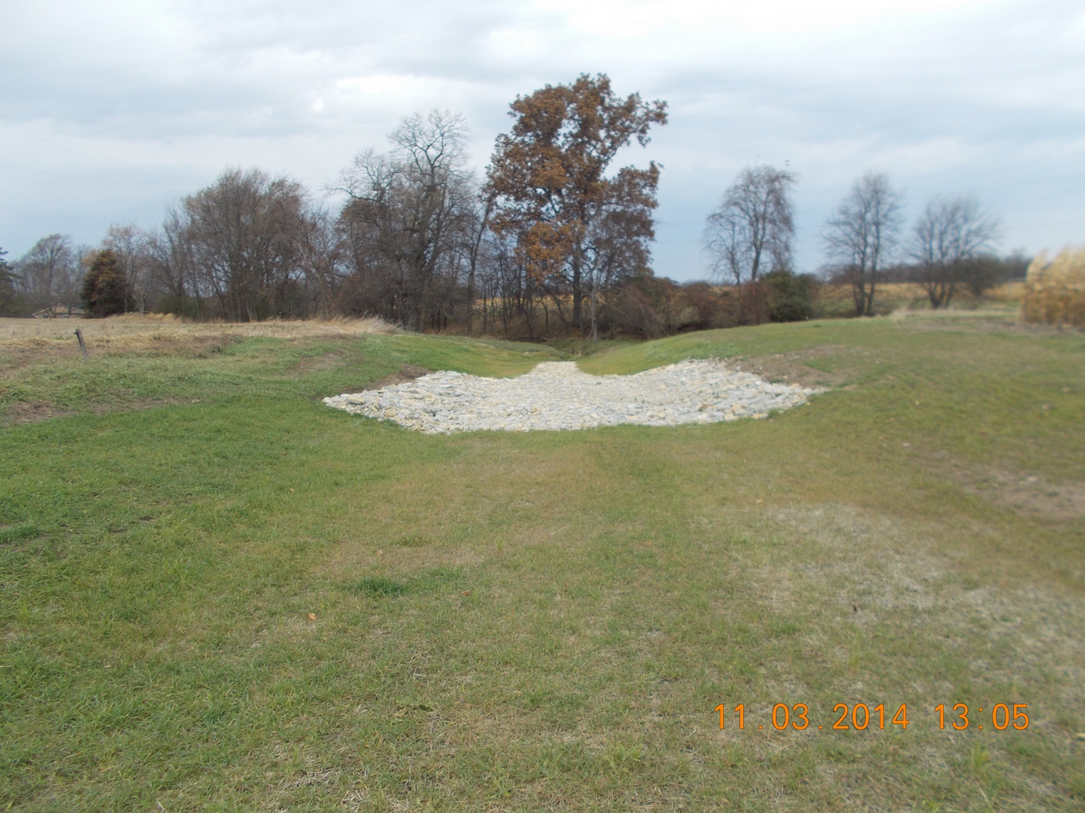
Waterways

Slide 18
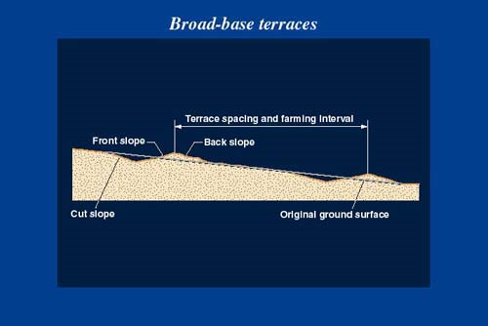
Terraces

Slide 19
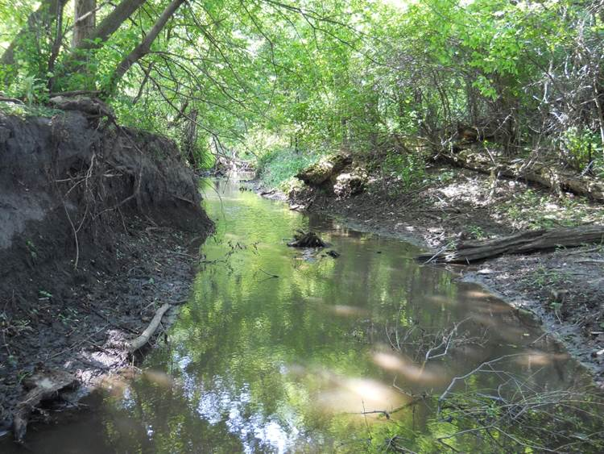
Typical Streambank Erosion

Slide 20
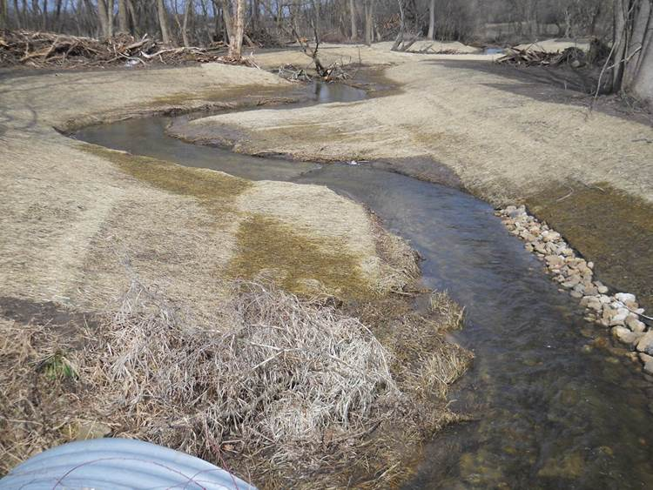
Streambank Protection

Slide 21
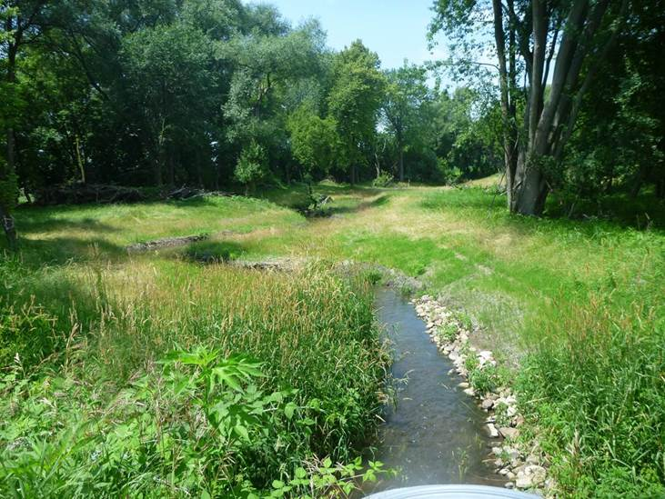
Stream 1 year later

Slide 22
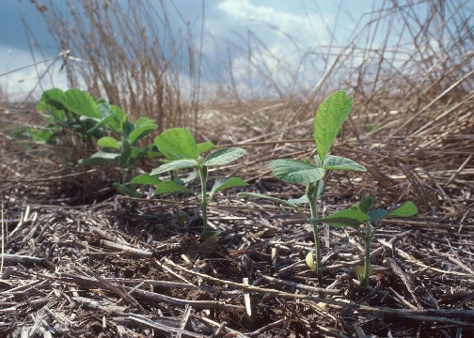
Soft Practice Example No-Till

Slide 23
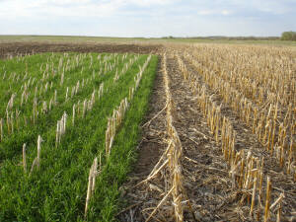
Cover Crops

Slide 25
Impaired Waters Status
Total Phosphorus > 0.015 mg/L
Green Lake @ 0.017 mg/L
Oxygen very low at Thermocline (30+ foot depth in Summer
3-7 ppm early 1900’s
Need to keep above 4 ppm for cold water fishery
Green Lake can get below 2 ppm in August of given years (reasons being studied)
Cause: Primarily from non-point pollution and internal loading (too much Phosphorus)

Slide 26
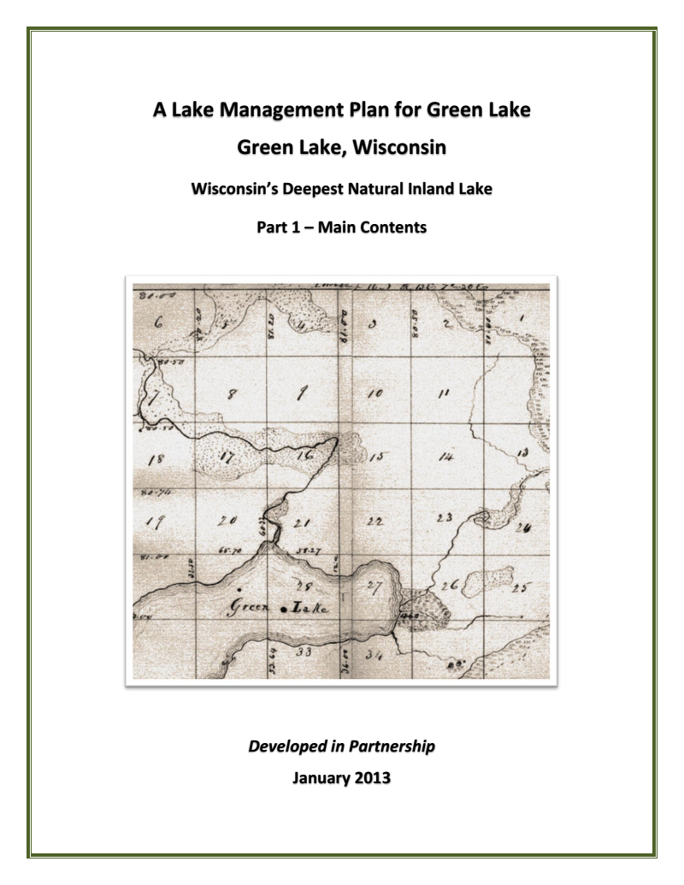
Lake Management Plan

Slide 27
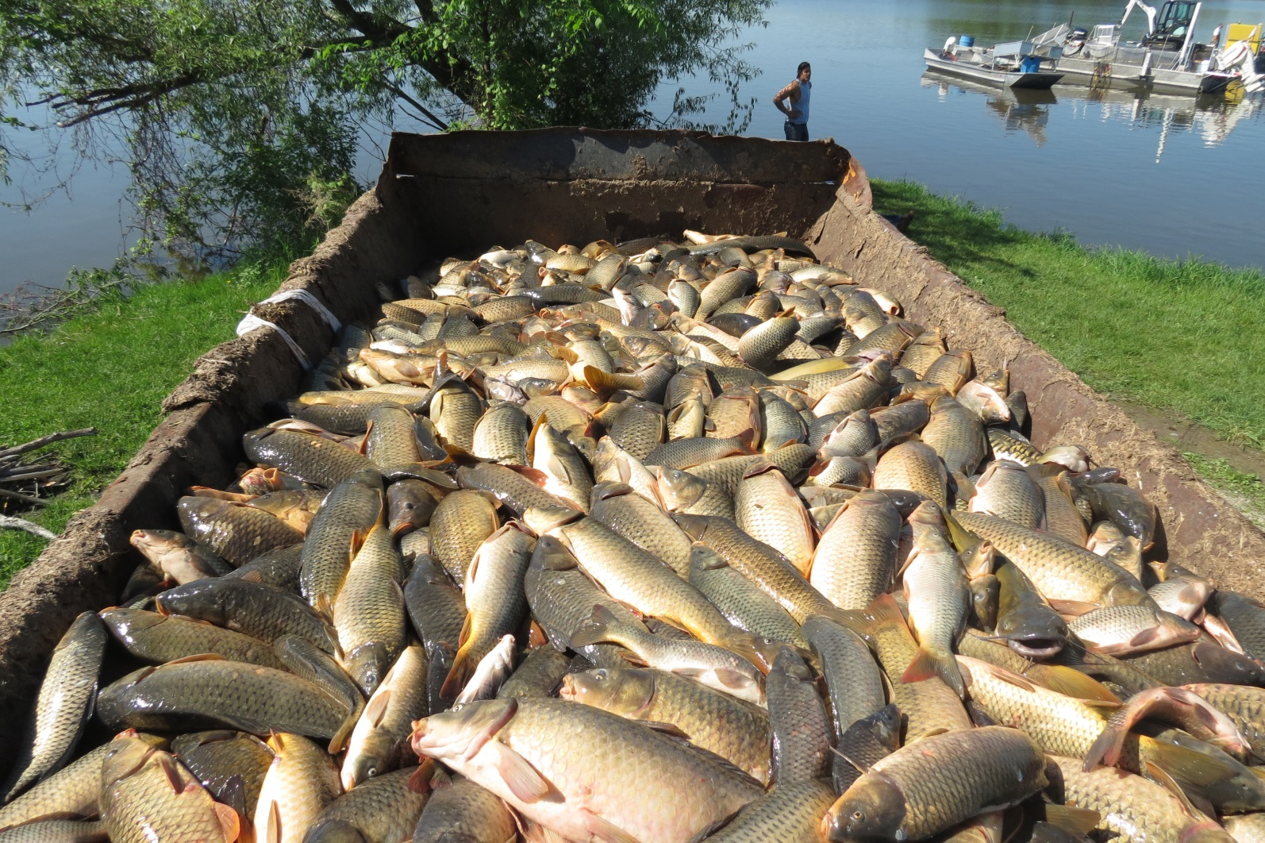
Restoration of County K Estuary
Carp Removal

Slide 28
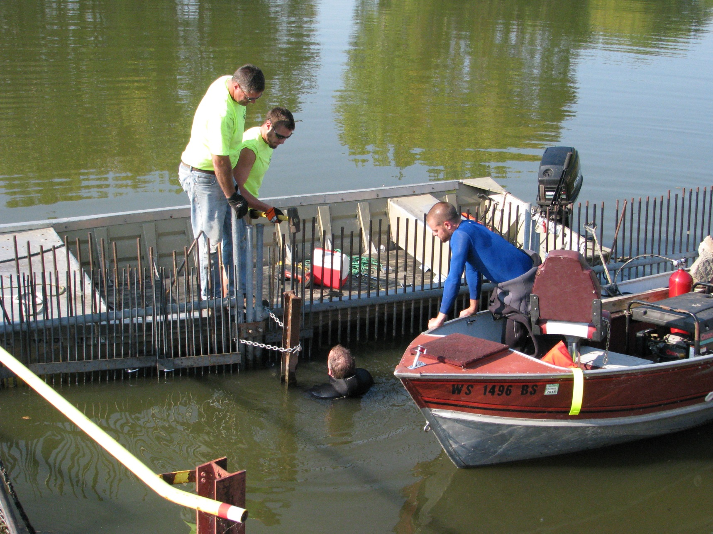
Carp Barrier

Slide 29
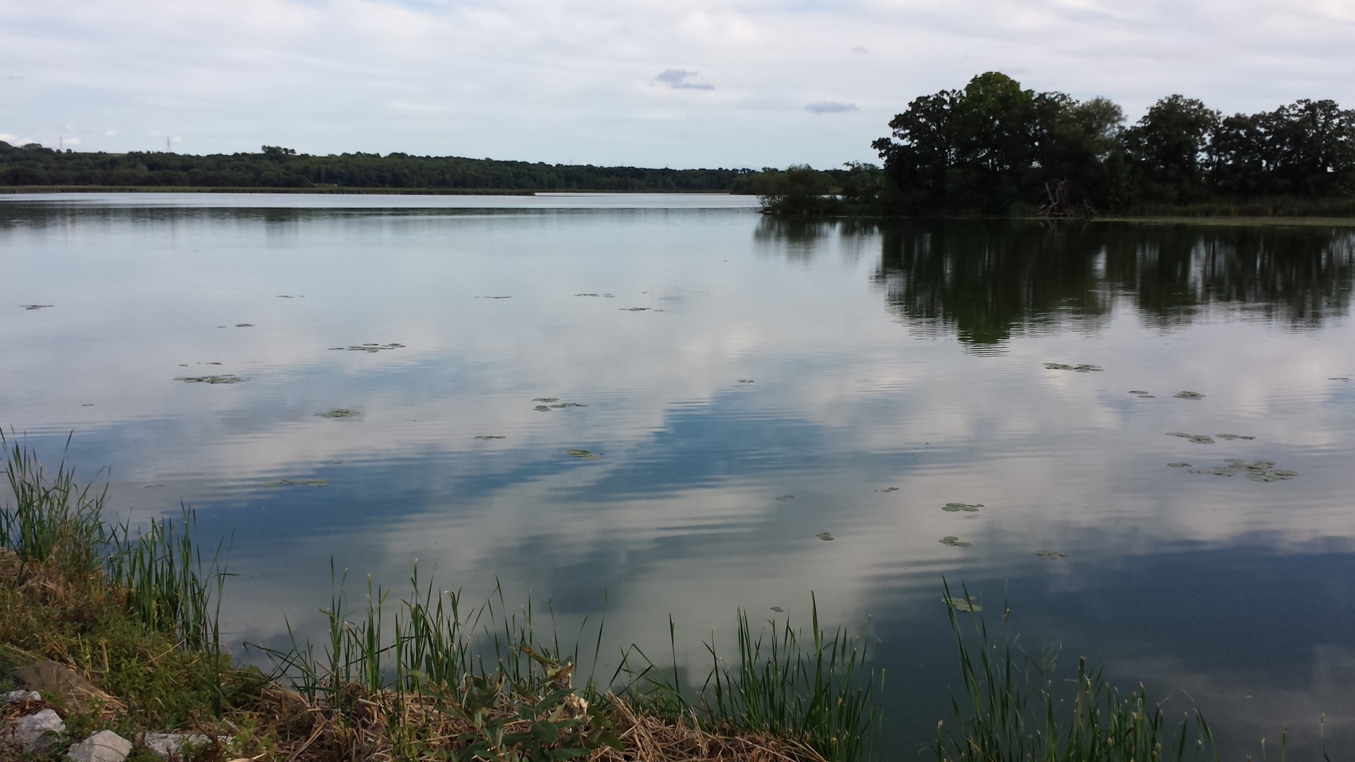
Restored Native Plant Growth

Slide 30
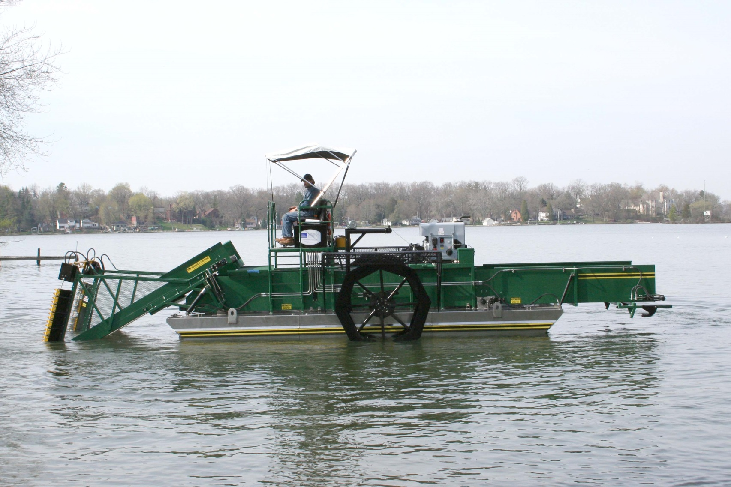
Aquatic Plant Harvester

Slide 31
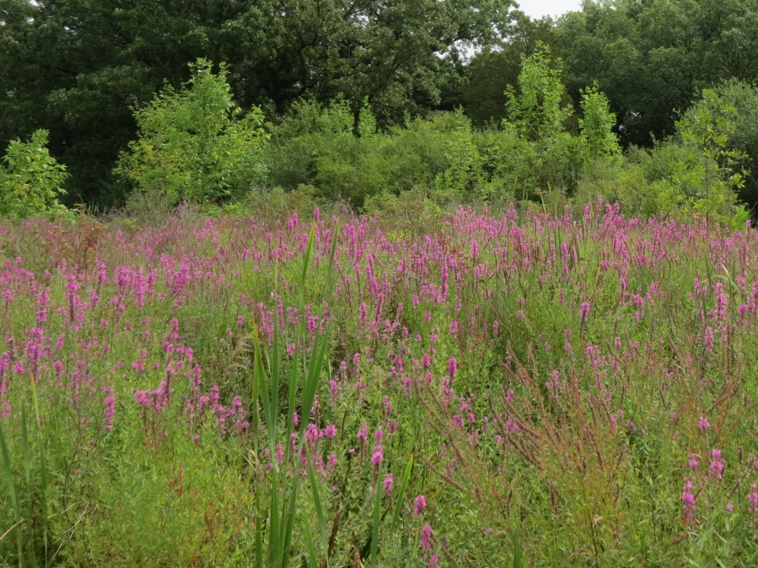
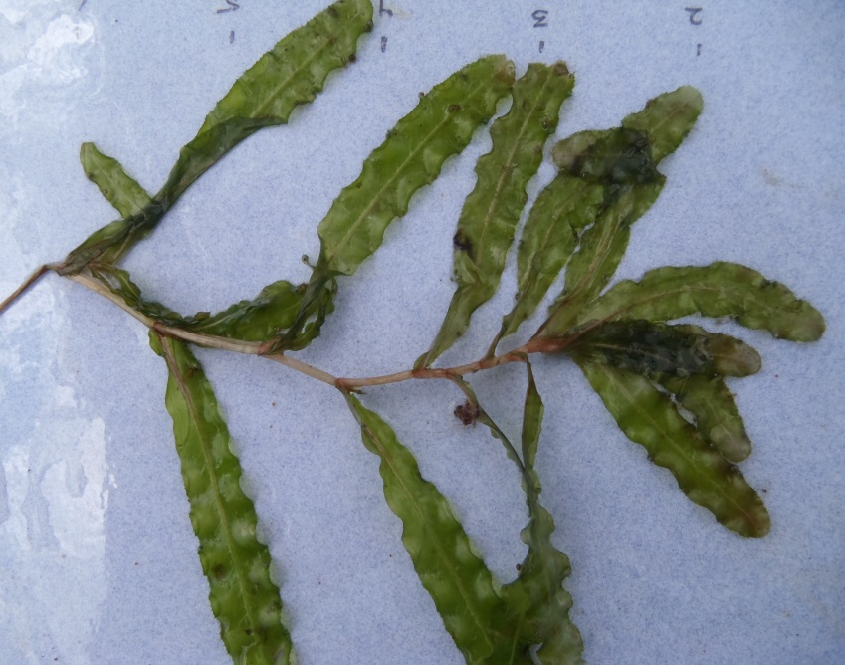
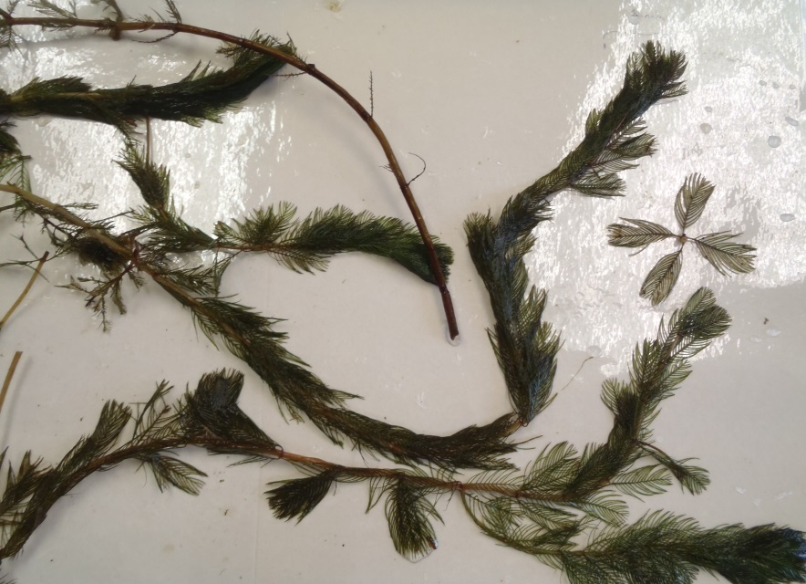
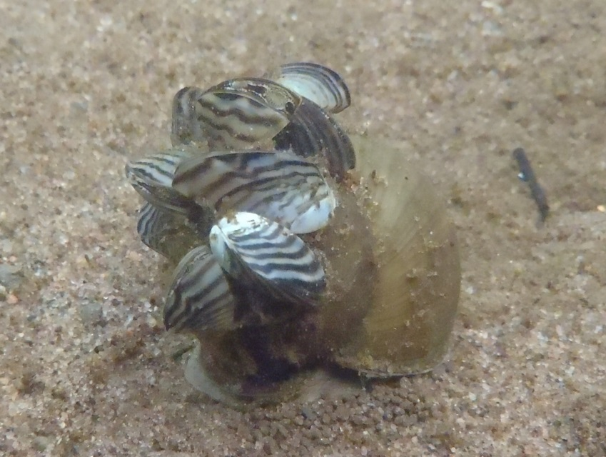
AIS Coordinator
Purple Loosestrife
Curly Leaf Pondweed
Eurasian Milfoil
Zebra Mussels

Slide 32
2015 Lake Protection Grant
Low DO Activities

Slide 33
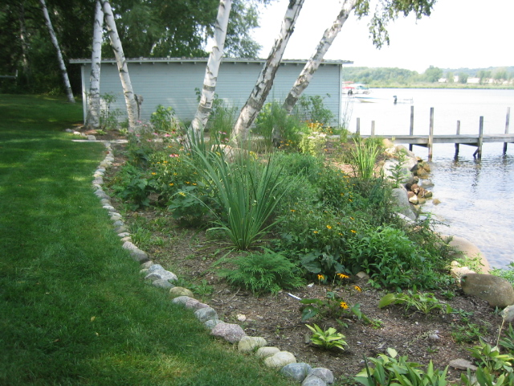
Shoreland Restoration

Slide 34
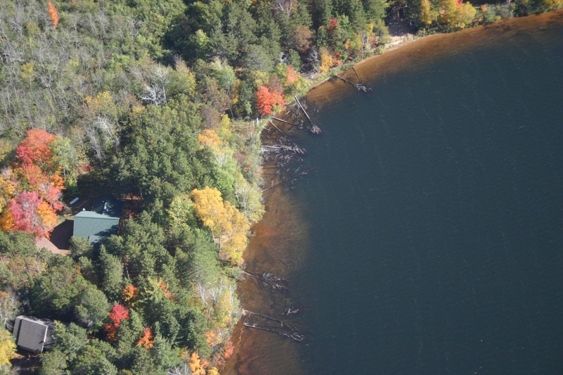
Fish Sticks

Slide 35
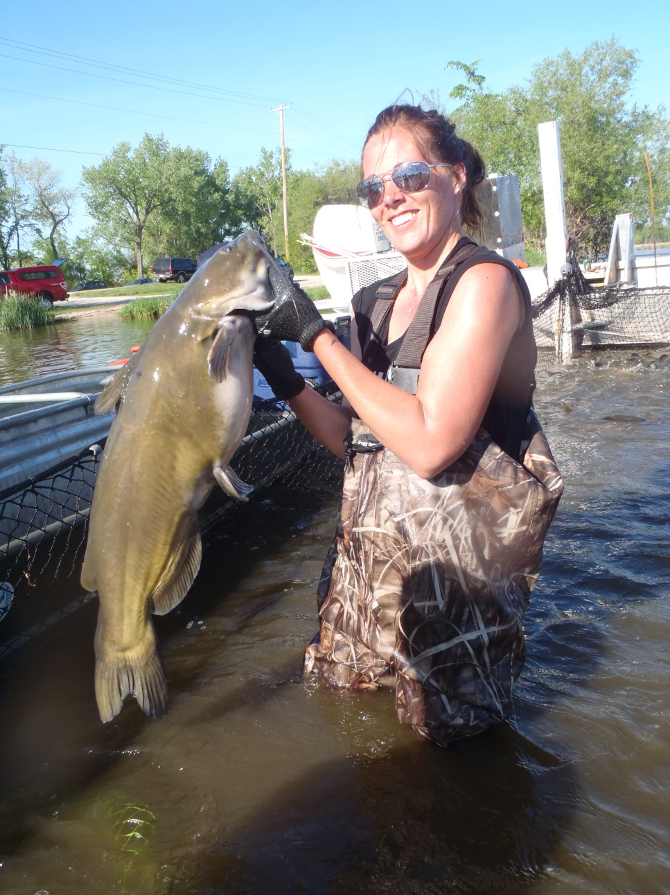
Continued County K Estuary Restoration

Slide 36
Summary
Truly a Team Effort…
Including the County Board Support!
Green Lake County Land Conservation Department
Design and Implementation of BMPs
Implement Lake Management Plan
(LMP Team)

